Slide 1
The price of validity in dynamic networks
DDS Practical Project
Fabio Massimo Ercoli - 802397
PART ONE: Problem analysis

Slide 2
Problem setting
Undirected graph G := (H, E)
H_{t} : set of hosts { h₁ , h₂ , . . . , h_{n} } at time t. D_{t} is the diameter at time t.
E: set of pairs (h, h’) symmetric neighbor relations between hosts h, h’ ∈ H
Aggregation queries functions (min, max, count, sum) issued by h_{q} (querying host)
v := q(H) : output
values of the hosts are query-dependent: we assume that the values are not known prior to receiving the query
hosts are also not aware of the values of their neighbor hosts

Slide 3
Distributed model
Unstructured overlay network
Undefined topology: generic graph
High churn rate - highly dynamic network
Crash-stop model
Fail stop process model: A host that leaves the network is called a failed host and does not participate in the network protocol anymore
Synchronous time model:
there are known upper bounds on process execution speeds, message transmission delays, and clock drift rates.
All of the above bounds can be integrated in a known universal maximum delay δ between ( h, h’ ) ∈ E

Slide 4
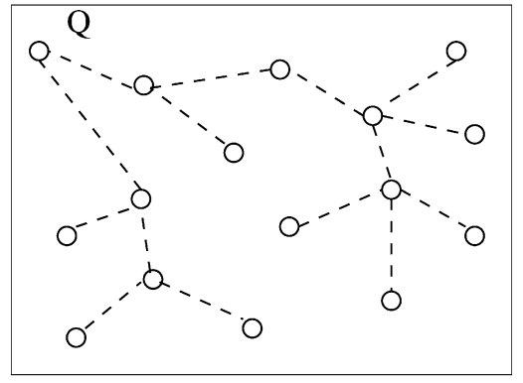
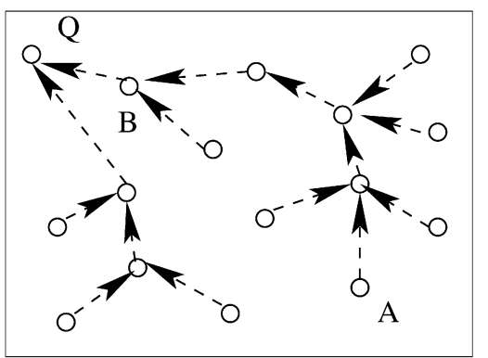
General Algorithm
Termination (liveness)
Validity (safety)
Correctness condition
One-time query semantics
What is the meaning of the answer to a query?
Implemented in two phases: broadcast & convergecast

Slide 5
Snapshot Validity
O: query start time - T: query end time - H_{t}: hosts at time t
Def ∃t ∈ [0, T]: v = q(H_{t})
We desire that the result returned be the exact value of the aggregate query at some time instant t in the interval [0, T]
There is no algorithm in the relaxed asynchronous model with reliable ordered communication that satisfies Snapshot Validity.
Proof: by contradiction, line topology, adding a new chain on h₁ at time t-1.

Slide 6
Interval Validity
Always present H_{I} = ∩^{T}_{t=0} H_{t} - Host that were alive at some instant H_{U} = ∪^{T}_{t=0}
Def ∃H: H_{I} ⊆ H ⊆ H_{u} ∧ v = q(H)
Interval Validity requires that v reflect data values that were in the network during query processing
Another impossibility result
Proof: by contradiction, ∃ h 1-connected to h_{q}, execute same algorithm on G and G - {h}, in which h’ (connects h-h_{q}) fails at time 1

Slide 7
Single-Site Validity
The path p_{h} is called stable if all the hosts h₀, . . . , h_{k}, and all connections (h_{i}, h_{i+1}), ∀i = 0, . . . , k − 1 are alive during the time interval [0, T]
H_{c} = hosts h : ∃ at least 1 stable path from h to h_{q}
Def ∃H: H_{c} ⊆ H ⊆ H_{u} ∧ v = q(H)
D_{h} = length of the shortest stable path from h to h_{q}
D = max_{h∈Hc}D_{h} stable diameter possibly to be overestimated by a reasonably small constant

Slide 8
Single-Site Validity
upon event < aq, Query | q > do
M := {attribute}
for all p ∈ Π
trigger < pl, Send | p, [QUERY, self, q] >
start-timer(2Dδ)
upon event < pl, Deliver | f, [QUERY, origin, q] > do
if (origin != self) then
for all p ∈ Π
trigger < pl, Send | p, [QUERY, self, q] >
trigger < pl, Send | origin, [RESULT, attribute] >
upon event < pl, Deliver | q, [RESULT, new-att] > do
M := M ∪ new-att
upon < Timeout > do
trigger < aq, QueryReturn | q(M) >
Can be satisfied in our model
Proof: ALL-REPORT algorithm archives Single-Site Validity
H ⊆ H_{u} contributions from alives (trivial)
H_{c} ⊆ H all hosts in H_{c} must have sent their values to h_{q} by time T

Slide 9
Continuous Single-Site Validity
Single-Site Validity can be extended to the Continuous Query
The query is registered by the user at time 0
Long-running characteristic of the query allows for 0 << t ⩽ T
Hc can degenerates to ⦰ => Single-Site Validity degenerates to a trivial requirement
Def given sufficiently large and explicitly stated W:
∃H: H_{c} ⊆ H ⊆ H_{U} ∧ v_{t} = q(H) ∧ H_{c}, H_{U} defined over [t-W, t]

Slide 10
Approximate Single-Site Validity
Def (1−ε) q(H) ≤ v ≤ (1+ε) q(H) with probability at least 1−ζ for some H_{C}⊆H⊆H_{U}, 0<ε<1 and 0<ζ<1
ALL-REPORT can be modified into RANDOMIZED-REPORT
H_{q} floods a message containing an additional parameter p
Each host that receives the message sends a 1 to h with probability p
Result v = |M|/p

Slide 11
Analysis of current solutions
ALL-REPORT pays a high price in terms of communication costs
SPANNING-TREE (hosts are organized into a spanning tree rooted at h_{q} during Broadcast). It is sensitive to failures as there is a unique path along which the attribute value from each host is propagated to h_{q}.
DIRECTED-ACYCLIC-GRAPH (providing each host with up to k parents, thus organizing the hosts into a directed acyclic graph)
Both these protocols forsake query semantics for communication efficiency, they may return results that are arbitrarily bad!

Slide 12
WILD-FIRE protocol
upon event < aq, Init > do
active := FALSE
t // local time (bounded skew)
upon event < aq, Query | q > do
active := TRUE
A := local-compute-max(q)
for all p ∈ Π
trigger < pl, Send | p, [BROADCAST, q, 0, D] >
start-timer(2Dδ)
upon event < pl, Deliver | from, [BROADCAST, q, t, D] > do
if (active = FALSE ∧ t < 2Dδ) then
active := TRUE
A := local-compute-max(q)
for all p ∈ Π
trigger < pl, Send | p, [BROADCAST, q, 0, D] >
BROADCAST
Node h_{q} set timeout to 2Dδ
On transition to active state:
The value of A (partial aggregate) is locally computed.
A broadcast message is sent to the neighbors to activate then.

Slide 13
WILD-FIRE protocol
upon active = TRUE do
for all p ∈ Π
trigger < pl, Send | p, [CONVCAST, q, A] >
upon event < pl, Deliver | from, [CONVCAST, q, A'] > do
if (t ≤ 2Dδ) then
Anew := combine(q, A, A')
if (Anew != A) then
A := Anew
for all p ∈ Π
trigger < pl, Send | p, [CONVCAST, q, A] >
else if (A != A') then
trigger < pl, Send | from, [CONVCAST, q, A] >
upon < Timeout > do
trigger < aq, QueryReturn | A >
CONVERGECAST
On this phase results are locally combined. If the combination produces a new result, the neighbors will be informed in turn.
When 2Dδ time passes the output of the query will be returned to the layer above.

Slide 14
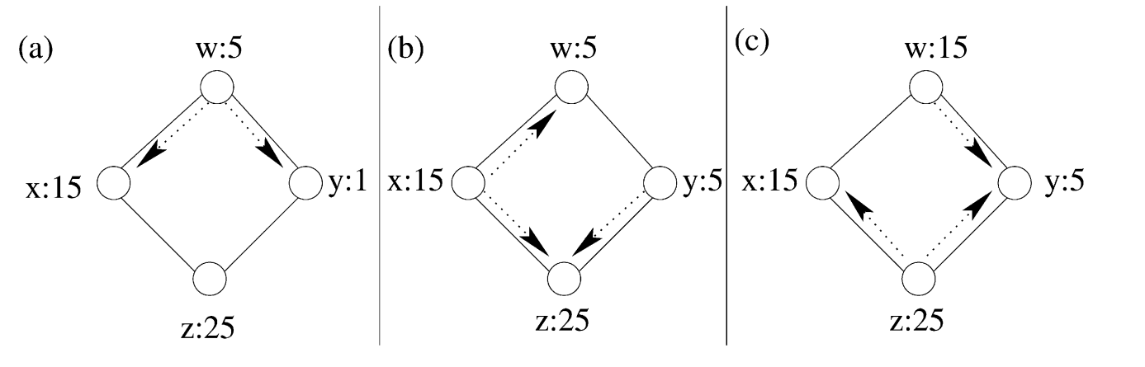
WILD-FIRE Execution
B(5)
B(5)
C(15)
C(15)
C(25)
C(25)
B(15)
B(5)
The execution suggests that the algorithm implementation can be improved…

Slide 15
WILD-FIRE / Single-Site Validity
Easy to proof for maximum or minimum aggregation functions.
Let h be connected to h_{q} through a stable path P of length at most L.
There are no failures on P
Broadcast message takes time at most Lδ to reach h
Convergecast message takes time at most Lδ to reach h_{q} s
If host h ∈ H_{C}, it participates in query processing
Only hosts h ∈ H_{U} participate in query processing
=> v = q (H) for some H_{C} ⊆ H ⊆ H_{U} .

Slide 16
Flajolet and Martin algorithm
Count and sum combining function (+) is duplicate sensitive
[FM] estimates the number of distinct elements in a set M = {v∈V}
c vectors {B_{i}} of size O(log|V|) bits
c exponentially distributed random functions {map_{i}} V -> [0, 2log|V|]
half the elements of V return 0
a quarter return 1, an eighth to 2, and so on…
∀ 1≤i≤c ∀v B_{i}[map_{i}(v)] = 1 z_{i} = lowest order bit that is 0 in B_{i}
z = mean{z_{i}} => m’ = 2^{z}/0.78 => Pr(1/c ≤ m’/m ≤ c) >= 1 - 2/c

Slide 17
WILD-FIRE Count
We can see B_{i} = ⋁(B_{i}^{v}), where B_{i}[map_{i}(v)] = 1 ∧ B_{i}[other] = 0
The broadcast message includes the param c
When h becomes active, it creates c vectors B₁^{h}, B₂^{h}, … , B_{c}^{h}
A total of c fair coin toss sequences are generated
Host h sets b_{i} bit in B_{i}^{h} to 1 where b_{i} is the index of the last Tail in the i-th sequence (simulation of map_{i} where h pretending to have a distinct element)
OR is a duplicate-insensitive operator, we can use WILDFIRE to assure Single-Site Validity of the final vectors and compute m’

Slide 18
WILD-FIRE Sum
The final output is an estimate of the sum of elements in M.
Each host wants to sum h pretending to have h distinct elements (instead of 1) from other hosts. Thus it runs the count procedure h times.
The host creates c vectors B₁^{h}, B₂^{h}, … , B_{c}^{h} of size O(log |M||V|) each:
1 ≤ i ≤ h B₁^{h,i}, B₂^{h,i}, … , B_{c}^{h,i} are produced
1 ≤ j ≤ c B_{j}^{h}=⋁(B_{j}^{h,i})
The broadcast message includes the param c and the estimate of log(M).
This time 2^{z}/0.78 is the sum. Pr(1/c ≤ v’/v ≤ c) >= 1 - 2/c

Slide 19
Continuous approximate count queries
N_{t} sample set of size s taken at t-th interval.
E.g., on expander graph topologies, the operation would perform s random walks of length O(log|H|) each.
Every host in the network has the same probability of occurring in a sample and leaving at each time.
M_{t} marked hosts, hosts alive during the sampling operation.
m_{t} = |M_{t} ∩ N_{t}| => m_{t}/|N_{t}| ≃ |M_{t}|/|H_{t}| => Ĥ_{t} = |M_{t}||N_{t}| / m_{t}
H_{q} probes all M_{t}’= M_{t-1}∪ N_{t-1}. M_{t} will be the alive hosts in M_{t}’.

Slide 20
WILD-FIRE Performance / Dependability
Worst case:
Every host can potentially observe an update of its partial aggregate at every time instant during the query processing time.
Each update causes a host to propagate aggregates to its neighbors causing 2D|E| messages (while SPANNING-TREE |E|+|H|)
reducible to 2D|H|, limiting the convergecast phase to (2D−l+1)δ, where l is the distance between hq and h.
Experiments on real-file network to see:
How much this worst case can be observed in practice? (Performance)
Is the Single-Site validity achieved in practice? (Dependability)

Slide 21
Empirical evaluation
WILD-FIRE, SPANNING-TREE and DIRECTED-ACYCLIC-GRAPH protocols are evaluated on real-life and synthetic networks.
We model host failures by removing a total of R randomly selected hosts from G at a uniform rate. R is varied from 256 to 4096 to characterize different degrees of dynamism.
Results are compared also with a perfect Oracle that detects reachability of each host from hq (not feasible in practice).
Communication cost: number of messages sent between any host pairs (h, h_{q}) in E
Computation cost at a host h: is the number of messages processed at h
Time cost: is the length of the longest chain of messages that occurs before the protocol terminates

Slide 22
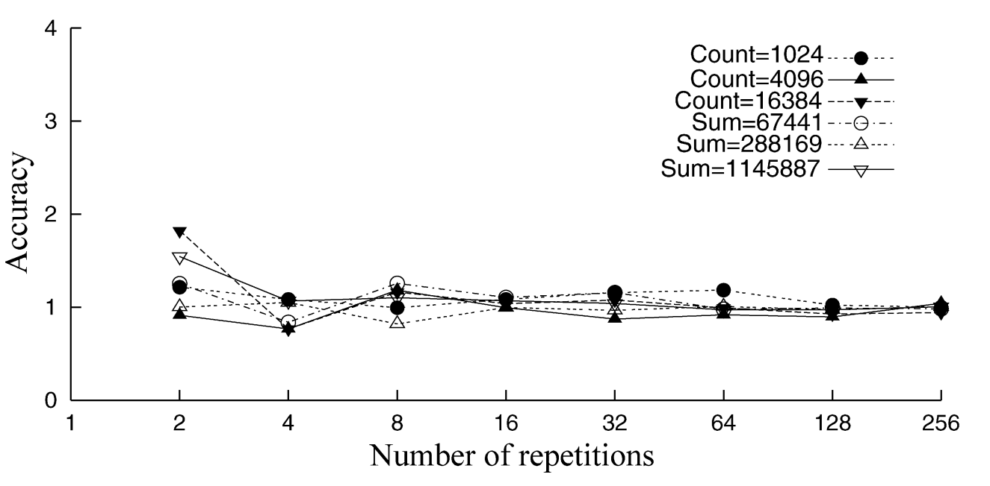
Accuracy of sum/count
m’/m
|M| = 2¹⁰, 2¹², 2¹⁴
c = {2, 4, 8, …, 256}
Overestimate: m’/m > 1
Underestimate: m’/m < 1
Perfect accuracy: m’/m = 1
m’/m quickly converges to 1 as c increases
we get very good accuracy for relative small c values (≈ 8)
c

Slide 23
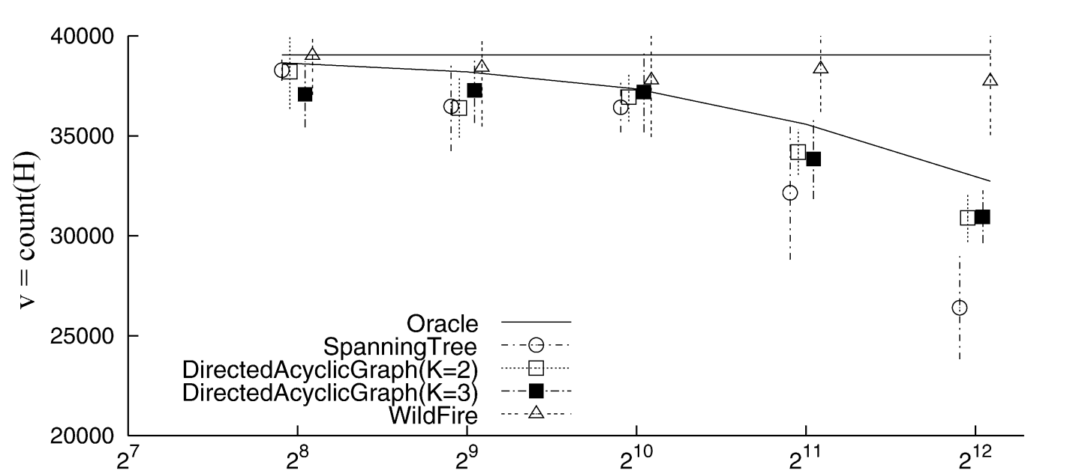
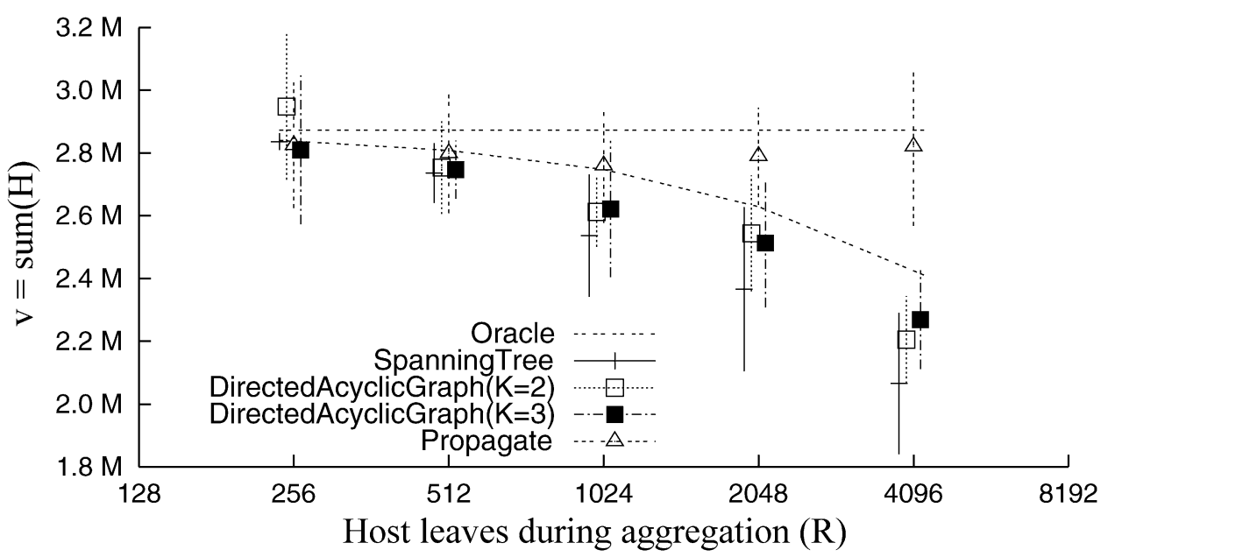
Achieving Single-Site Validity
Evaluated on different degrees of dynamism in the network (R)
v=q(H) is less than 95% confidence level => H ⊂H_{c} => single site validity is violated
WILD-FIRE continues to return values within the Single-Site Validity bounds even for high dynamism rates
Same results for other synthetic topologies (Random, Power-Law and Grid)

Slide 24
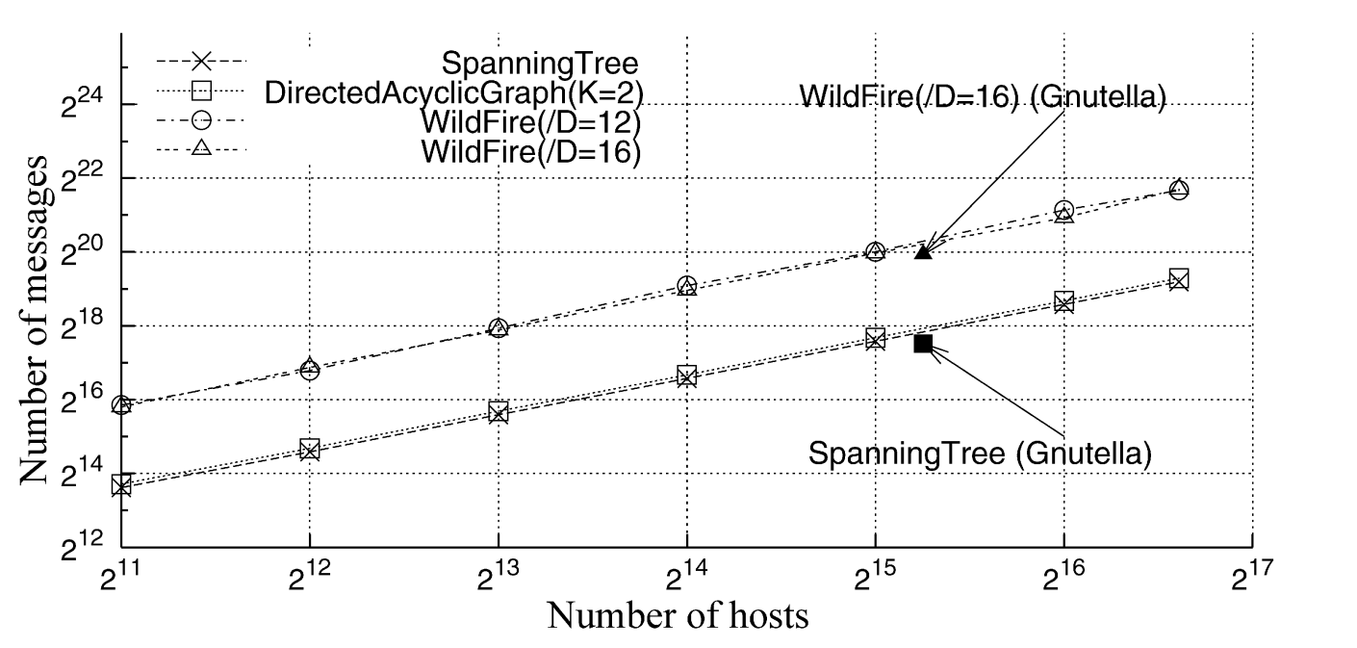
Price of Single-Site Validity
Communication costs are independent of how much D’ overestimates D.
In DIRECTED-ACYCLIC-GRAPH and SPANNING-TREE the cost of Broadcast (|E|) dominates that of Convergecast (k|H|). So their curves overlap.
WILD-FIRE incurs 4 times higher communication cost.
Similar ratio was observed on Power-Law topologies.
Results for a count query on Random topologies.

Slide 25
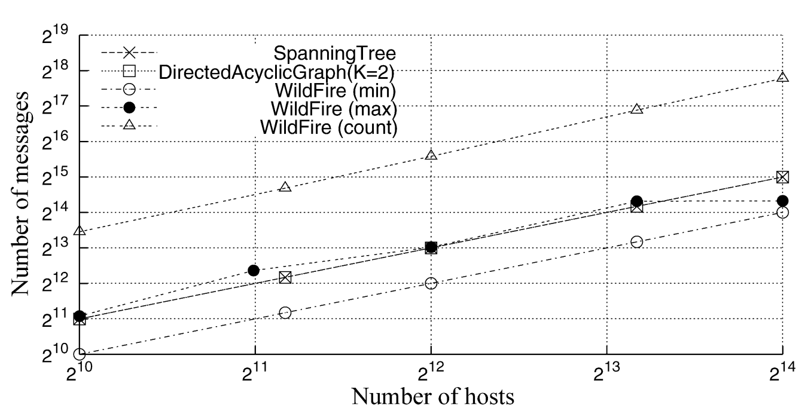
Price of Single-Site Validity
DIRECTED-ACYCLIC-GRAPH curve overlaps SPANNING-TREE as the cost of sending messages to k 1 parents is the same.
WILD-FIRE incurs 5 times higher communication costs for count queries.
Costs of maximum queries are smaller than that for count.
Costs for minimum are smaller than those for SPANNING-TREE!
Thanks to the early aggregation performed by WILDFIRE. Convergecast starts as soon as a host becomes active, before Broadcast has completed.
|H| on Grid Topologies, with hosts having broadcast capabilities (host a message to all its neighbors via a single message)

Slide 26
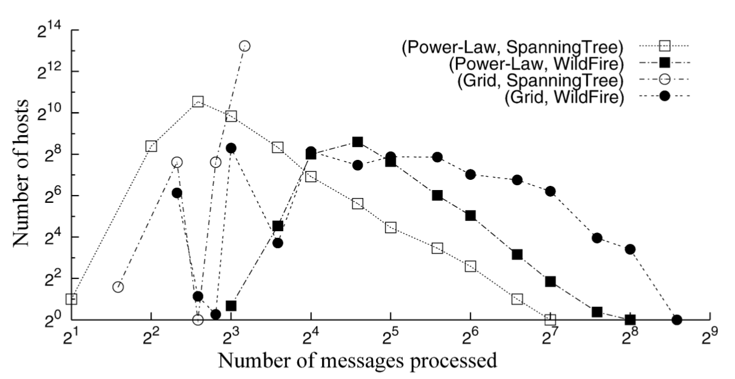
Computation cost
on Power-Law WILD-FIRE pays a computation cost that is 2 times higher than that of SPANNING-TREE
on Random 4 times higher
on Grid 44 times higher
In SPANNING-TREE: the Convergecast phase is directed from a host to its parent in the spanning tree.
In WILD-FIRE: each message is sent by a host to all its 8 neighbors and it requires 5 times more messages than SPANNING-TREE on the Grid topologies.
≝ The maximum number of messages processed by a host (maximum non-zero X value)

Slide 27
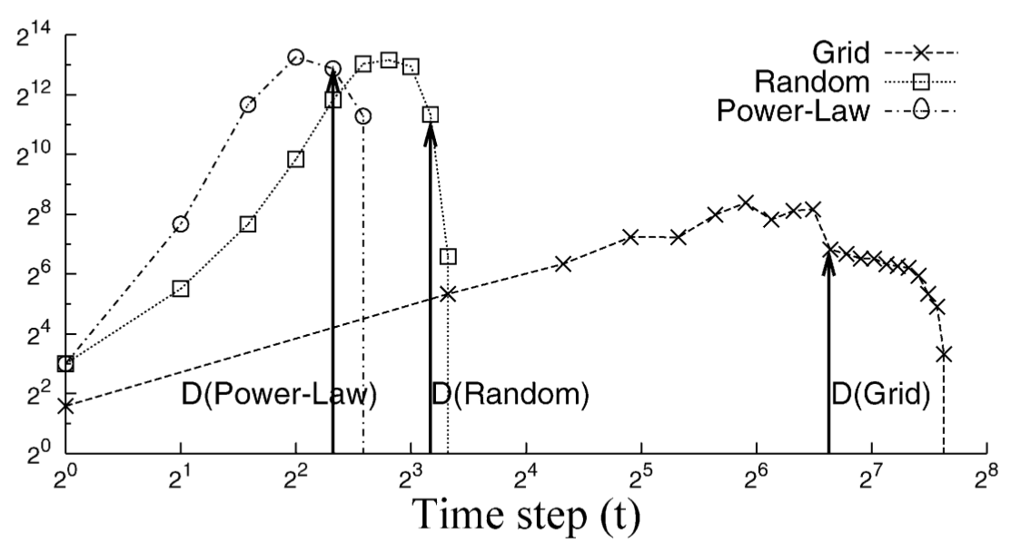
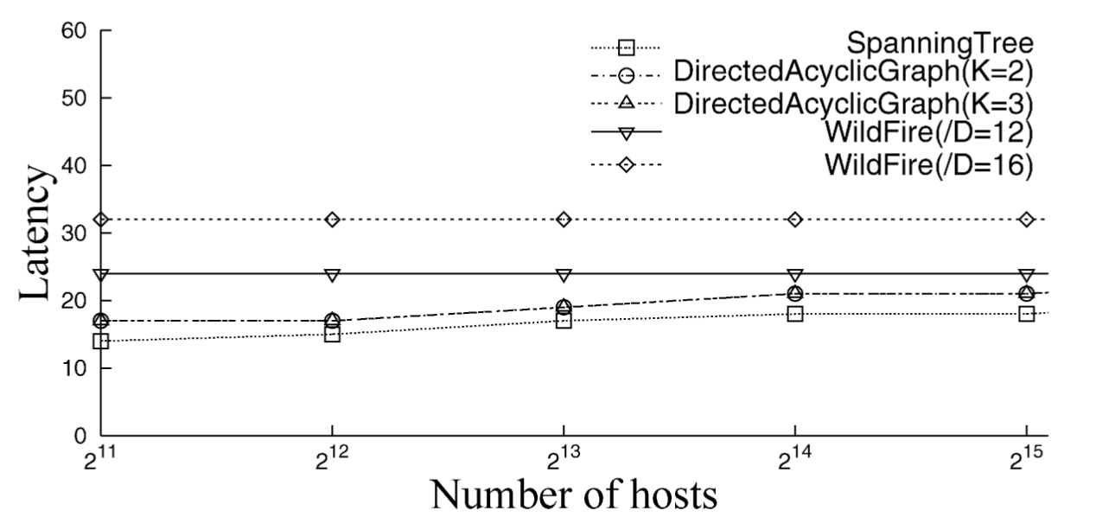
Time cost
WILD-FIRE latency is 2D’δ
D’ increases time cost proportionally
Overestimate D has an impact on time cost, while it doesn’t on communication costs.
WILDFIRE for a count query on the synthetic topologies.
The number of messages peaks close to Dδ. It decreases to 0 by time 2Dδ.
No message during [2Dδ, 2D’δ].

Slide 28
The price of validity in dynamic networks
DDS Practical Project
Fabio Massimo Ercoli - 802397
PART TWO: WILDFIRE Implementation

Slide 29
WILD-FIRE Implementation
Sending a convergecast message to all the neighbors each time a node delivers a convergecast message that updates the local value A could be expensive.
In the implementation I’m proposing we apply a batching strategy, buffering all the convergecast messages received at each turn and applying them only when the turn finishes (a turn lasts for δ time).
When a node is activated it always sends the broadcast message and its first convergecast message to all the neighbors.
We can merge the messages types broadcast and convergecast, piggybacking the current A on the broadcast message.

Slide 30
WILD-FIRE Implementation
upon event < aq, Query | q > do
active := TRUE; t0 := now(); pendings := ∅
start-timer(δ)
D := estimate-diameter()
A := local-compute-query(q)
for all p ∈ Π
trigger < pl, Send | p, [DATA, q, t0, D, A] >
upon event < pl, Deliver | from, [DATA, q, t0', D', A'] > do
if (now()-t0' < 2D'δ) then
pendings := pendings ∪ {from, q, t0', D', A'}
if (active = FALSE ∧ timer is not started) then
start-timer(δ)
upon < Timeout > do
if (now()-t0' < 2D'δ) then
process-pendings()
start-timer(δ)
else
active = FALSE
trigger < aq, QueryReturn | A >

Slide 31
WILD-FIRE Implementation
procedure process-pendings() do
if (pendings != ∅) then
if (active = FALSE) then
t0 := pendings[0].t0
D := pendings[0].D
A := local-compute-query(q)
processes := Π
forall c ∈ pendings do
Anew := combine(c.q, c.A, A)
processes := processes - {c.from}
forall c ∈ pendings do
if (c.A != Anew) then
trigger < pl, Send | c.from, [DATA, c.q, c.t0, c.D, Anew] >
if (Anew != A | active = FALSE) then
A := Anew
forall p ∈ processes
trigger < pl, Send | p, [DATA, pendings[0].q, t0, D, A] >
active := TRUE
pendings := {}

Slide 32
Synthetic implementation
The idea it to contribute with an implementation of the WILD-FIRE protocol to support aggregated queries to the project: https://github.com/krzysztof-turowski/distributed-framework.
This project already has several modules to set up, test and benchmark synthetic distributed algorithms.
The networks are synthetic, because each node is not an independent process on an independent machine, but a goroutine, whose real degree of parallelism is determined by the Go-engine. (concurrent ≠ parallel).
But thanks to synthetic utilities such as synchronizers, channels, graph generators and failure generators, a real distributed system seems to be pretty well simulated.
On the other hand, it would be very expensive to run and test our algorithm on a real distributed system.

Slide 33
Golang concurrency primitives
A goroutine is a lightweight thread managed by the Go runtime
Channels can be used to send messages between and synchronize goroutine
By default, sends and receives block until the other side is ready
The select case statement lets a goroutine wait on multiple communication operations
In the project mutexes are not used, since memory is never shared, but synthetic nodes can only uses channel to communicate (to simulate real nodes)

Slide 34
Distributed framework main objects
Node: index, linked to neighbor nodes
Runner / Synchronizer: process n events (for a given time duration or a given number of rounds) on a set of nodes, collecting time, #rounds and #messages
Generator: generate unique indexes
Graph builders: empty, random, tree, ring, complete, torus, hypercube, hamiltonian, directed, undirected, …
Metrics: #messages - #rounds - time elapsed (duration)

Slide 35
Program parameters
n: number of nodes of our random graph
edgeProbability: probability of an edge will be generated between any pair of node
faultyProbability: probability that a given edge may become faulty and if an edge is faulty the probability that may crash at each round
query: can be (min, max, count, sum)
diffValues: local query values will be in the range [0, diffValues-1] for max and [diffValues-1, 0] for min
diameterExtimation: an overestimation of the diameter of the random graph
output: the result of the distributed query and the #message exchanged

Slide 36
WILD-FIRE Execute Algorithm
> git clone -b wildfire git@github.com:fax4ever/distributed-framework.git
> [distributed-framework] go run example/wild-fire-aggregation-query.go 5000 0.01 0.2 max 50 2
Params are: n edgeProbability faultyProbability query diffValues diameterExtimation
Values can be changed on the main / test file
> [distributed-framework] go test -timeout 30s -run ^TestWildFireAggregationQuery$ github.com/krzysztof-turowski/distributed-framework/test
The full algorithm is on the file: https://github.com/fax4ever/distributed-framework/blob/wildfire/aggregation/wild_fire/wild_fire.go
[Demo time]

Slide 37
The price of validity in dynamic networks
DDS Practical Project
Fabio Massimo Ercoli - 802397
Thank you

